Slide 1
IBM Data Science Professional Certification
Applied Capstone Project
Recommending a Friend where to open a Sub-Saharan African Restaurant

Slide 2
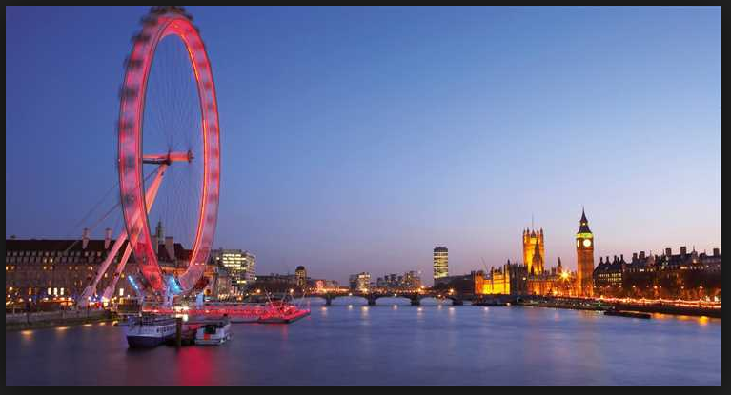
Introduction
Image from https://www.google.de/search?q=London+Bridge&stick=H4sIAAAAAAAAAONgFuLQz9U3MIxPNlECswrMzdO1-Jzzc3Pz84IzU1LLEyuLF7Hy-uTnpeTnKTgVZaakpwIAEcvDtjYAAAA&source=lnms&tbm=isch&sa=X&ved=0ahUKEwio0MeE743iAhUQDewKHaPUA_wQ_AUIDigB&biw=1920&bih=969#imgrc=wkiZII0B8holcM:
According to Wikipedia, London is the largest City in the UK and has been a major settlement for two millennia now. London is also considered one of the world's most important global cities in the world with attributes such as most visited, most infleuntial, most expensive and most vegetarian freindly city in the world

Slide 3
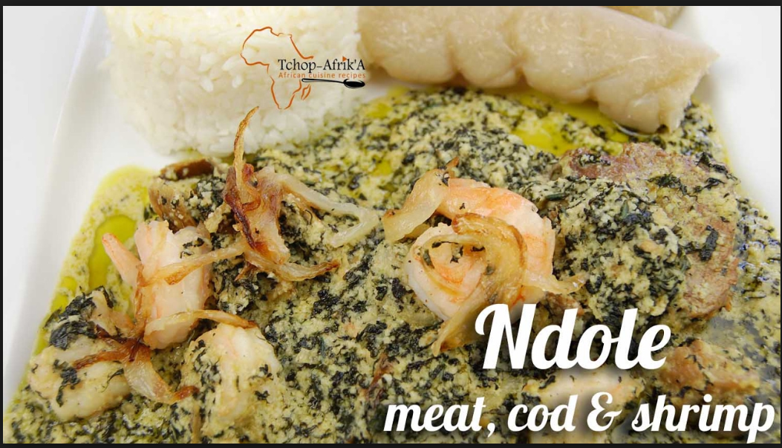
Business Problem and Data Set
Image from Google
The idea of this project is to locate the best Neighborhood in London to open a Restaurant for people of Sub-Saharan African descend.

Slide 4
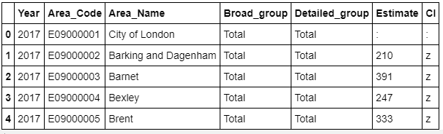
Data Set
The data that would be used for this project is the immigration data taken from the London data store. This data presents Annual population survey based on diversity or country of birth. This data is published by the office for national statistics (ONS).

Slide 5
Variable Description
- Year tells us the year in which the survey was conducted
- Area_Code is the code of the area in which the survey was conducted
- Area_Name is the name of the area in question
- Broad_goup tells us if the people surveyed are British, from the European Union or Non-European Union
- Detailed_group specifies where the people surveyed exactly came from. e.g from north america or south asia
- Estimate provides the estimated total number of people surveyed in thousands

Slide 6
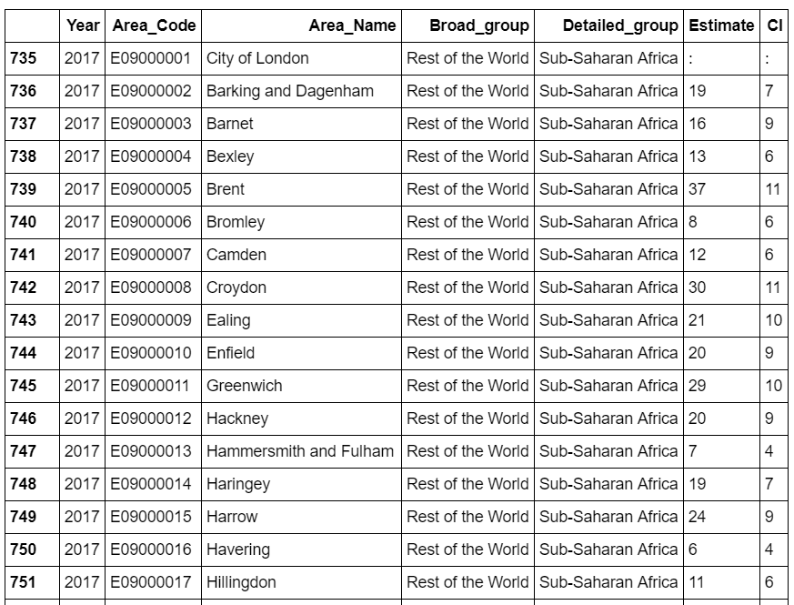
The Sub-Saharan Data
A snapshot of the data set looks like this

Slide 7
Methodology
After retrieving the data,i prepared the data in such a way that we only had the data we need to proceed with our analysis (data with Detailed_group = Sub-Saharan Africa
Entries with funny estimates or null values were excluded while i used Foursqaure to get information about african Restaurants in and around London
Then i made use of the Euclidean Clustering method to classify the African Restaurants in and around London by their Neighborhoods.

Slide 8
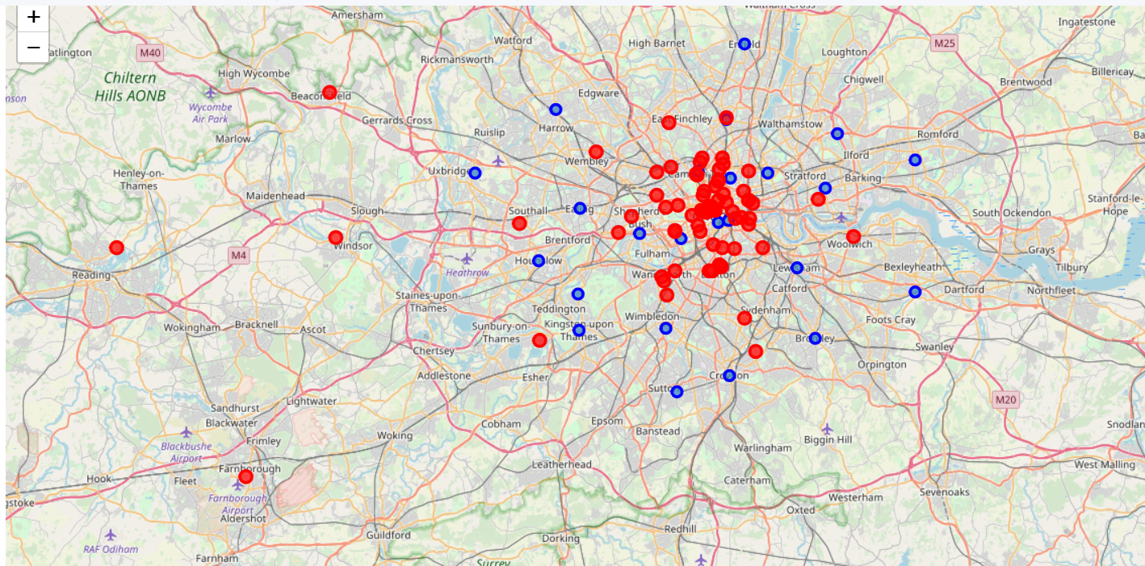
Methodology Position of african Restaurants in the London Neighborhoods

Slide 9
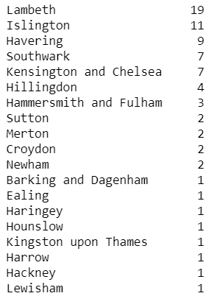
Results
From the results on the right, we can see that though the sub saharan population has continuously been high or increasing in Croydon and Ealing, there are only 2 and 1 African Restaurant in these Locations.

Slide 10
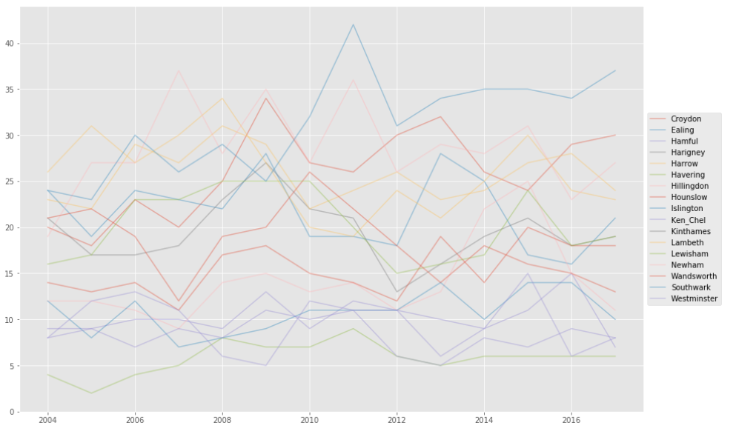
Results
Croydon and Ealing are the two regions where more Sub-Saharan Africans are moving to as can be seen in the time series plot below

Slide 11
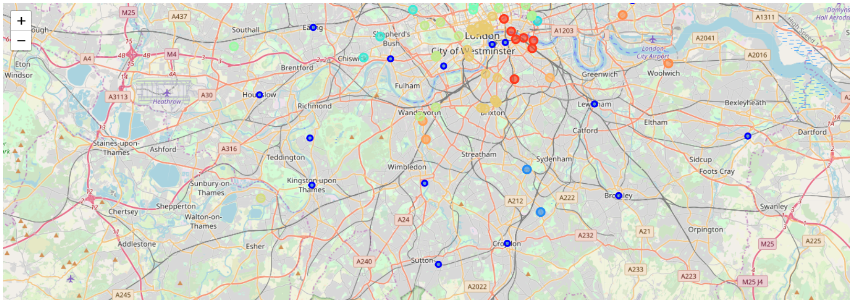
African Restaurants clustered into 6 categories as shown below

Slide 12
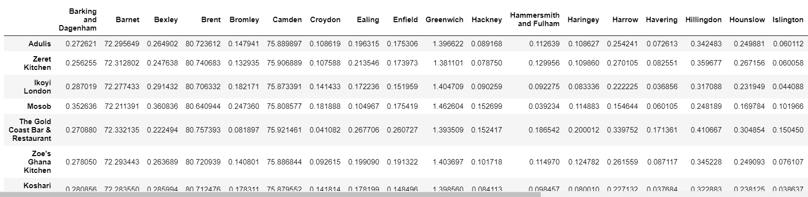
Euclidean Distances

Slide 13
Discussion
I noticed that using the foursquare data, one can get different results with the Geocode especially when you rerun the notebook
One could thing of using another Clustering Method to compare results but from the euclidean method i used, i would recommend My friend to open the African Restaurant either in Croydon or Ealing

Slide 14
Conclusion
This project helped me to put some hands on into what we practiced about using foursqaure data to really draw maps and explore neighborhoods

Slide 15
Thanks for Reading through

